Slide 1

Introduction to:
Parallel and Distributed Computing
CSC4010
David Cutting – d.cutting@qub.ac.uk

Slide 2
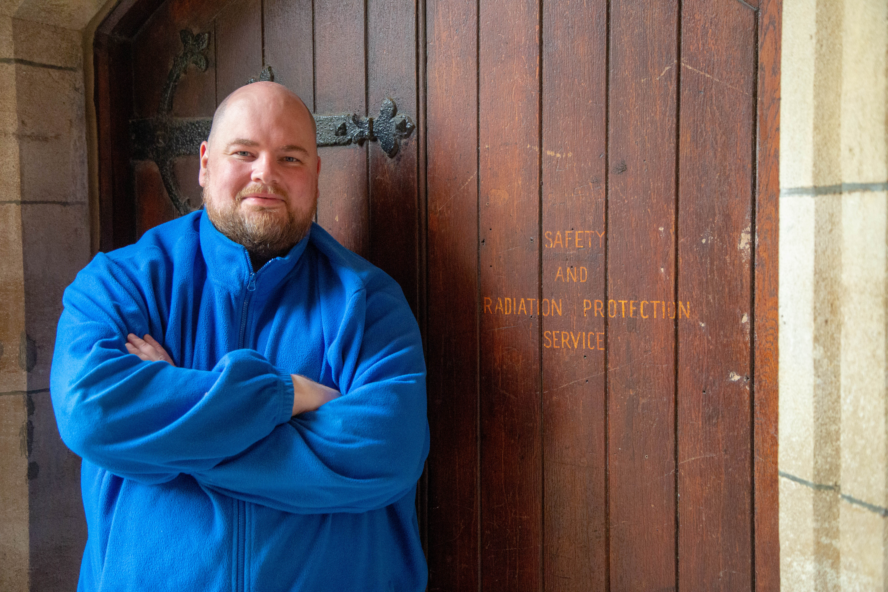
Hello

Slide 3
Parallel and Distributed Computing
New module in 2022/23… fourth fifth time’s the charm ☺
Building on existing changes to the curriculum looking at modern deployment and development (i.e. Cloud)
Revising a module focussed entirely on high-performance computing to include some broader topics

Slide 4
Parallel
Locally-located high density computing (traditional HPC)
Often same chip/backplane (threads/processes)
Shared storage and memory
High speed and reliable communication links

Slide 5
Distributed
Widely geo-distributed nodes
Not the same chip/backplane
Not sharing memory and storage (or very difficult/slow to)
Slow and unreliable communication links

Slide 6
Assessments – DATES SUBJECT TO CONFIRMATION
100% coursework
Project 1: Parallel Computing (50%)
  Released start of week 4 due start of week 7
Project 2: Distributed Computing (50%)
  Released start of week 9 due start of week 12

Slide 7
Technology
Parallel:
  Kelvin 2 HPC Cluster (Linux-based SLURM cluster)
  C with OpenMP
Distributed:
  Wider choice of languages – looking more at concepts and theory

Slide 8
Technical Skills/Knowledge
C
OpenMP
Linux
Networking
…

Slide 9
Timetable
1 x 3 hr lab/workshop (Tuesday from week 2)
1 x 2 hr lecture/seminar (Wednesday from week 1; this session)
Office hours bookable

Slide 10

?
?
?
?
?
?
?
?
?
?
?

